Slide 1
USING VIDEO TO TAKE A CLOSE LOOK AT TEACHING: SOME THEORY AND LOTS OF PRACTICE
DR. ROSSELLA SANTAGATA
CHRISTINA KIMMERLING
PATRICIA FUENTES ACEVEDO

Slide 2
SESSION GOALS
Conceptualize teacher noticing in practice
Notice aspects of students' thinking
Value access to student thinking as a means to make instructional decisions

Slide 3
AGENDA
Introductory noticing activity
What is noticing?
Overview of the project NIMS²: Noticing in Mathematics for Students Success
Noticing in university teaching
Closing reflections

Slide 4
CHILDREN’S BRILLIANCE: LISTENING TO STUDENT THINKING
Kindergarten children (5 - 6 years old) were given the following word problem:
On St. Patrick’s Day, Megan found 4 gold coins. Megan’s brother, Ryan, found some too. If they found 10 gold coins altogether, how many gold coins did Ryan find?

Slide 5
CHILDREN’S BRILLIANCE: LISTENING TO STUDENT THINKING
On St. Patrick’s Day, Megan found 4 gold coins. Megan’s brother, Ryan, found some too. If they found 10 gold coins altogether, how many gold coins did Ryan find?
What did students appear to understand mathematically?
How did the instructor make student thinking visible?

Slide 7
CHILDREN’S BRILLIANCE: LISTENING TO STUDENT THINKING
Opportunity to listen to and unpack student thinking:
Counting on, and then seeing adding 6 more
Decomposing 5 + 5 into 4 + 6
Teacher moves that support and build from student thinking:
Creating space for students to share
Providing ample wait time
Listening and revoicing
Use of representations

Slide 8
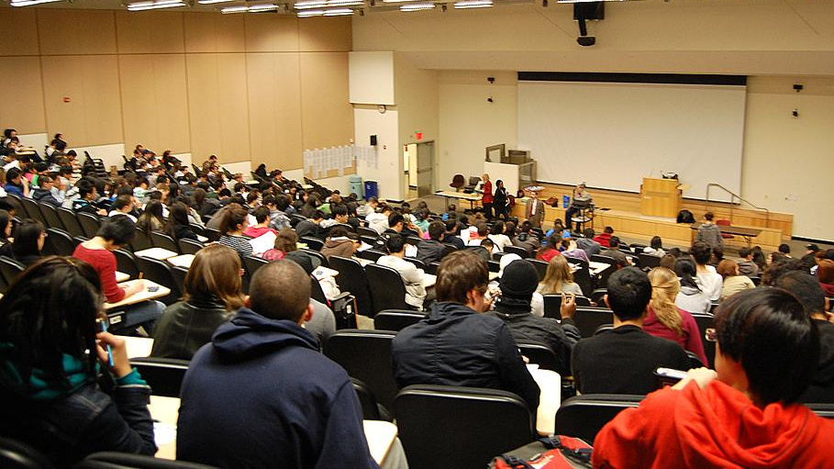
WHAT DOES A TYPICAL UNIVERSITY LESSON LOOK LIKE?

Slide 9
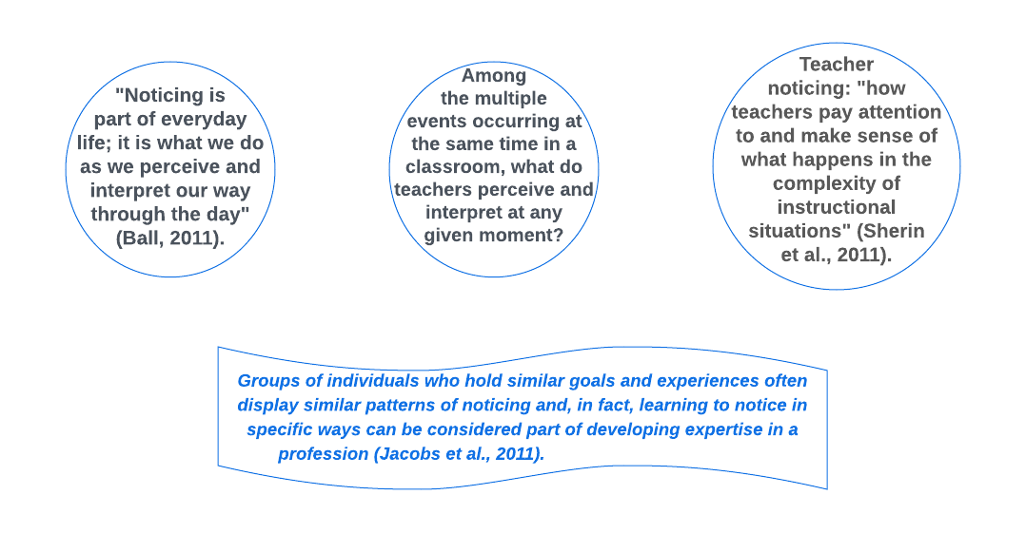
TEACHER NOTICING
Haga clic para agregar texto

Slide 10
Reflective noticing
Moment-to-moment noticing
(Kersting et al., 2021)

Slide 11
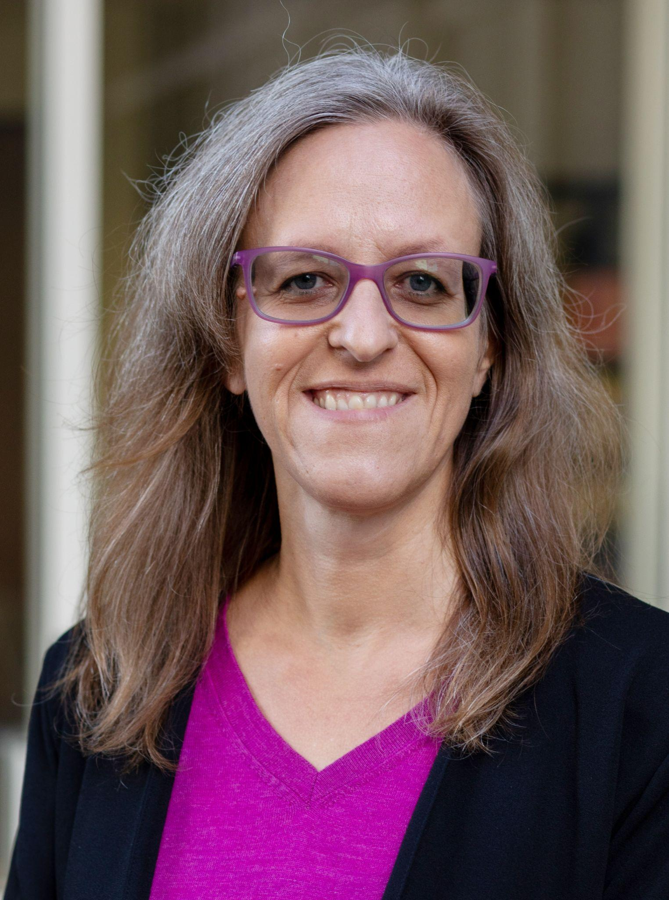
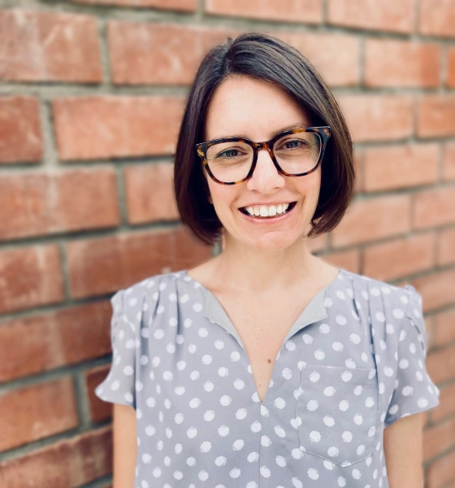
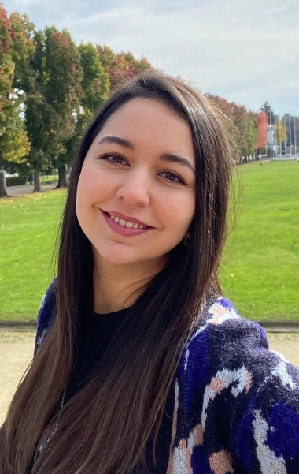
NOTICING IN MATHEMATICS: A VIDEO-ANNOTATION CURRICULUM TO ENHANCE INSTRUCTORS' UNDERSTANDING OF STUDENT THINKING IN PROOF-TRANSITION COURSES
NIMS²: NOTICING IN MATHEMATICS FOR STUDENTS SUCCESS
CO-PRINCIPAL INVESTIGATORS
ROSSELLA SANTAGATA
ALESSANDRA PANTANO
ROBERTO PELAYO
RESEARCH TEAM
PATRICIA FUENTES ACEVEDO
VICTOR ARROYO
CHRISTINA KIMMERLING
HUA LIN
DANIEL MORRISON

Slide 12
GOALS OF NOTICING CURRICULUM
Proof Framework
Develop knowledge of core practices of proof writing (framework)
Noticing Construct
Develop understanding of noticing as a construct and why its important in teaching
Noticing Competence
Develop noticing competence (attending, shaping, reasoning/interpreting)
Equity
Incorporate equitable practices into vision of mathematics teaching

Slide 13
COURSE CONTEXT
Introduction to Abstract Mathematics
Emphasis on rigorous proof writing in mathematics
Traditionally difficult course for students
Lecture and discussion section format
Selected Clips
It is fine if this clip does not represent your course structure
Opportunity to discuss and reflect on real practice and to zoom in to student thinking

Slide 14
OBSERVE, TAKE NOTES, SHARE
What do you notice in this clip?

Slide 15
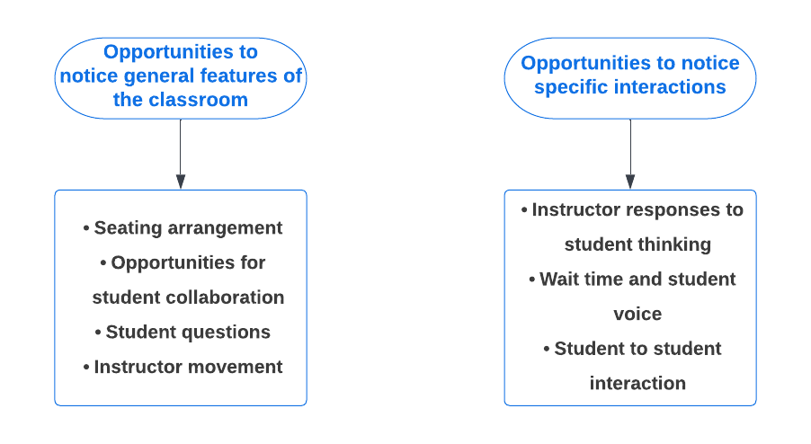
KEY IDEAS FROM THE CLIP

Slide 16
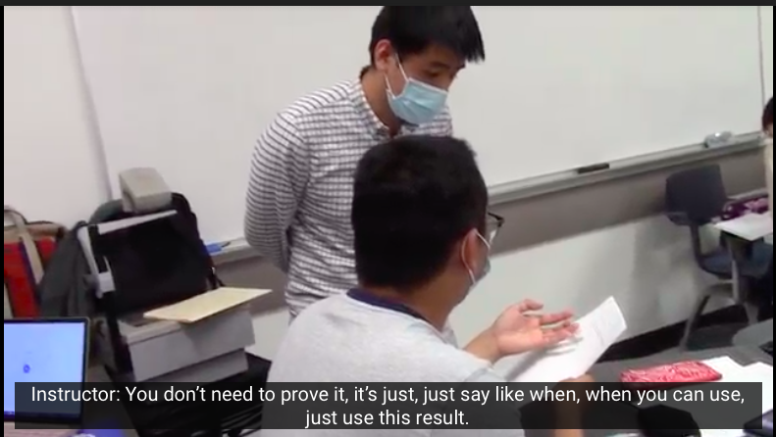
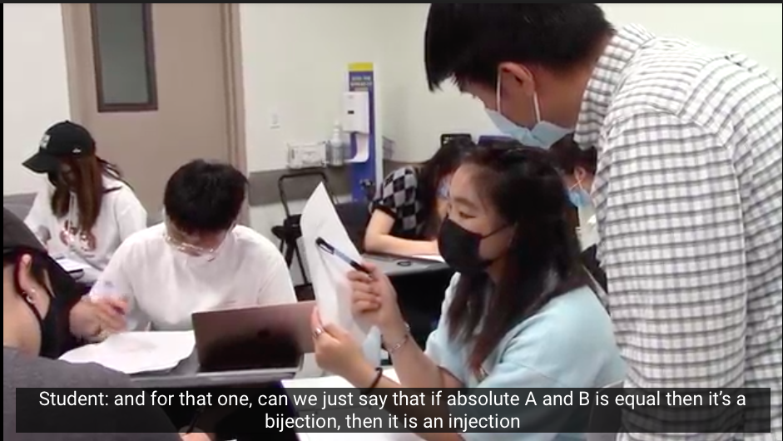
NOTICING OF SPECIFIC INTERACTIONS
Instructor responses to student thinking | Wait time and student voice

Slide 17
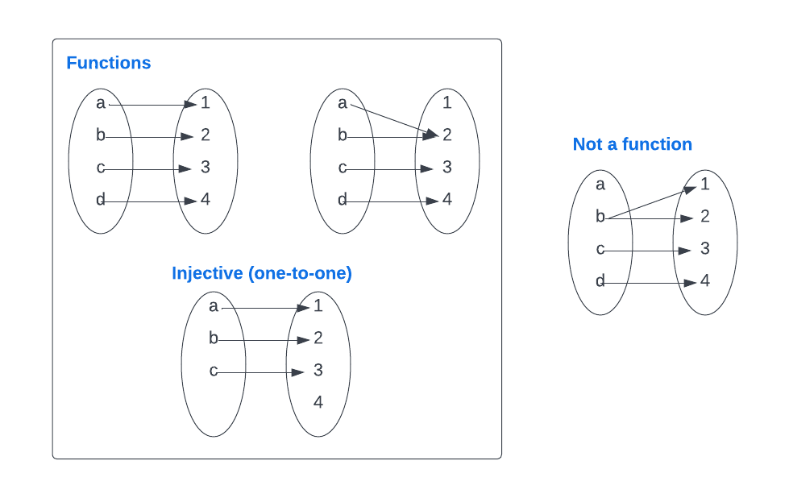
TASK
Let A, B be finite sets. If there exists an injective function f : A → B,
then what can we say about the relationship between |A| and |B|? Try to justify your claim!

Slide 18
LET'S OBSERVE MORE... WHAT DO WE NOTICE NOW?
Question Set A
Question Set B
What does the student in the video appear to understand mathematically?
What do we know about the students mathematical thinking from the clip?
What questions do you have about the student’s mathematical thinking?
What do you notice about the student’s participation in this lesson?
What do you wonder about the student’s participation in this lesson?

Slide 20
RESPONDING
Question Set A
Question Set B
What could you ask the student to better understand her thinking?
What are some alternative instructional moves you would propose?
How can more opportunities be created for this student and her classmates to participate in meaningful ways?

Slide 21
KEY IDEAS FROM THE CLIP
We identified an opportunity to build on student thinking and support meaningful participation within the context of the lesson
Responding to student thinking in productive ways can be difficult, requiring both disciplinary and pedagogical expertise
Zooming in to the moment and rewatching it allows us to discuss alternative strategies

Slide 22
THE EXPERIENCE OF DEVELOPING NOTICING SKILLS USING VIDEO
How difficult was it to attend to and interpret the students' thinking?
What aspects of your identity do you think determine what you did and did not notice?
How was it to discuss as a group the aspects of the students' instruction and thinking that you noticed?

Slide 23
PERSPECTIVES OF NOTICING
Zooming Out
Socio-cultural Perspective
Zooming In Cognitive Perspective

Slide 24
CONNECTIONS TO YOUR OWN CONTEXT
Providing opportunity to listen to student thinking
How does this work resonate with you?
Responding productively to build on and from student thinking

